Slide 1

Automatic watering system

Slide 2
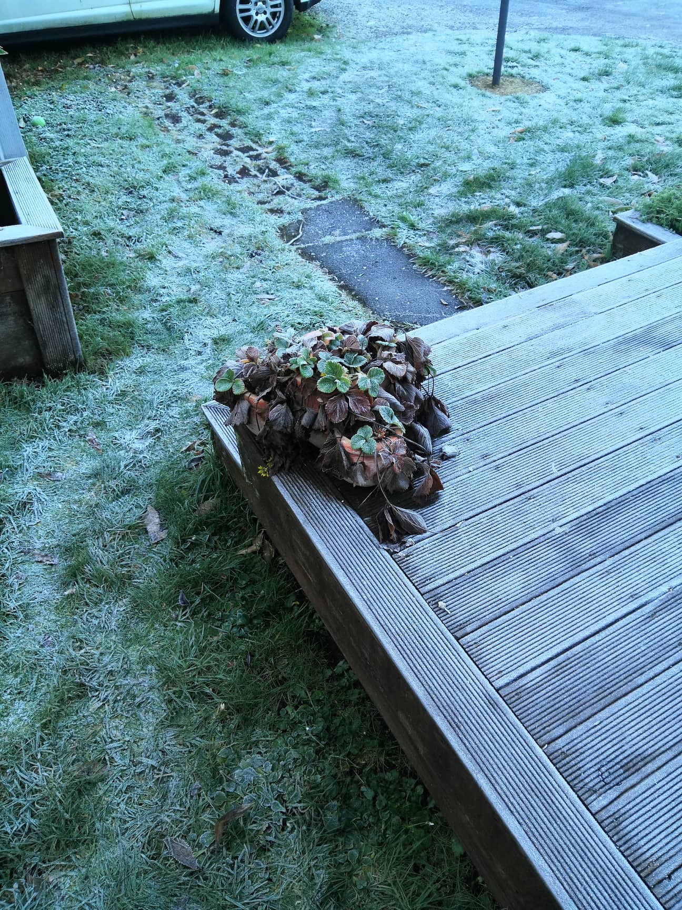

Slide 3

Reasons for design
I am forgetful
I like strawberries
Helps with experimenting on productivity

Slide 4
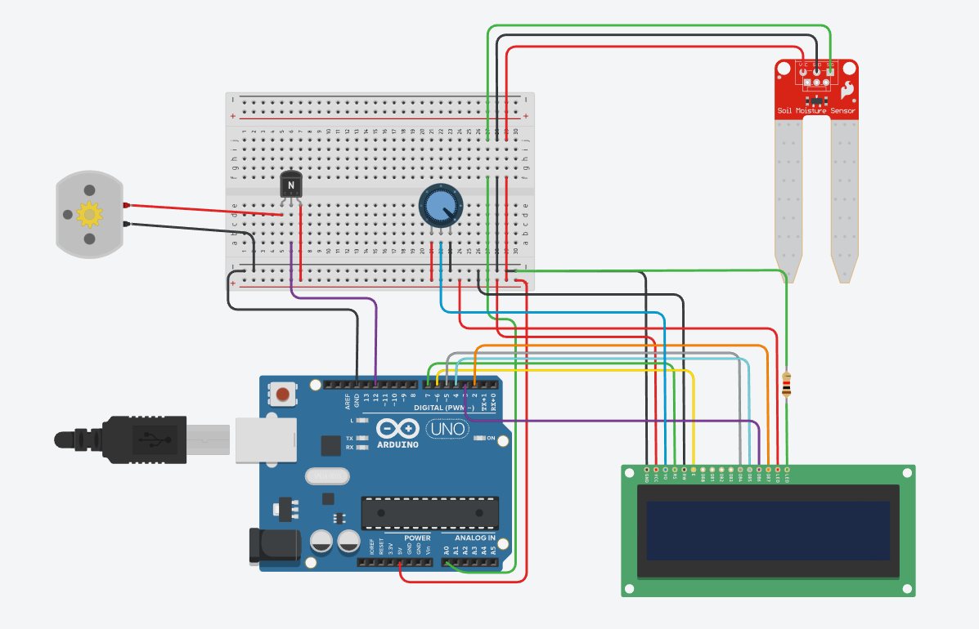

Slide 5
Current non implemented features
Pump
Water container
UV lightbulb

